Slide 1
Java Web
Servlets

Slide 2
Disclaimer
Document Name:
Data Classification: INTERNAL
Disclaimer
The contents of this document are property of Softtek, and are classified as Confidential. Any reproduction in whole or in part is strictly prohibited without the written permission of Softtek.
This document is subject to change. Comments, corrections or questions should be directed to the author.
Audience/Viewership | Purpose
Java Beginners | Training
Revision Chart
The following chart list the revisions made to this document. Use this to describe the changes and additions each time this document is re-published. The description should be detailed as possible and include the names of the reviewers who request the changes.
Version No. | Version Date | Types of Changes | Owner/Author | Date of Review/Expiration
1 | 2015/08/05 | Creation | Luis Robles | NA

Slide 3
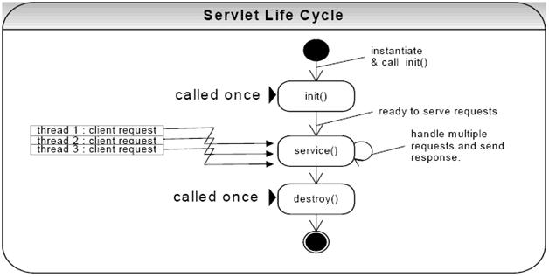
Lesson 2: Servlets

Slide 4

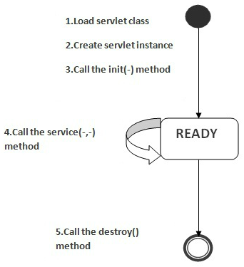
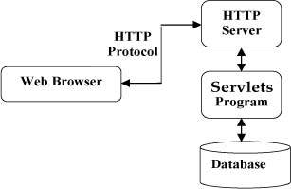
Java Servlets
Java Servlet API allows a software developer to add dynamic content to a Web server using the Java platform
It is a server side Java program which extends the functionality of application or web server
Servlet is a specification whose implementations are done by various server vendors to develop web application.

Slide 5
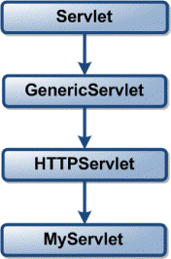
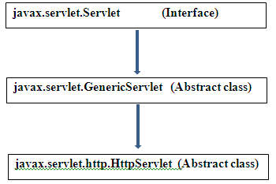
Servlet hierarchy

Slide 6
Servlet hierarchy (cont.)
javax.servlet.Servlet :
It is an interface with collection of abstract methods in order to build web applications.
javax.servlet.GenericServlet :
It is a class provided by the server vendor which is used for developing protocol independent web applications.
javax.servlet.http.HttpServlet :
It is also a class provided by the server vendor. It is used for developing protocol dependent web application (HTTP).
Most of the real time web applications are protocol dependent i.e HttpProtocol.
Http Protocol is a stateless protocol which always reserves the state of the client to some extent of time only.
Note:
If we want to develop the web application specific to a Http protocol, then the corresponding class must be extended by HttpServlet class.
Similarly, if we want to develop the protocol independent web application, then our servlet class should be extended by GenericServlet class.

Slide 7
Servlet hierarchy (cont.)
The javax.servlet and javax.servlet.http packages provide interfaces and classes for writing servlets
Those packages are a standard part of the Java's Enterprise Edition
All servlets must implement the Servlet interface, which defines lifecycle methods
When implementing a generic service, you can use or extend the GenericServlet class provided with the Java Servlet API
The HttpServlet class provides methods, such as doGet and doPost, for handling HTTP-specific services

Slide 8
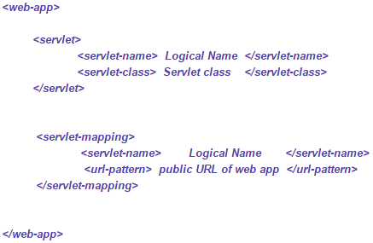
Java EE deployment descriptor
web.xml file is a standard Java EE deployment descriptor which is specified in the Java Servlet specification.
Another name for web.xml file is Web deployment descriptor or Web configuration file.
The main purpose of web.xml file is to populate the technologies used in the web application development
Sample structure of web.xml file
It instructs the servlet container (Tomcat for example) which classes to load, what parameters to set in the context, and how to intercept requests coming from browsers.

Slide 9
Java EE deployment descriptor (cont.)
web.xml file contents:
what servlets (and filters) you want to use and what URLs you want to map them to
listeners - classes that are notified when some events happen (context starts, session created, etc)
configuration parameters (context-params)
error pages, welcome files
security constraints

Slide 10
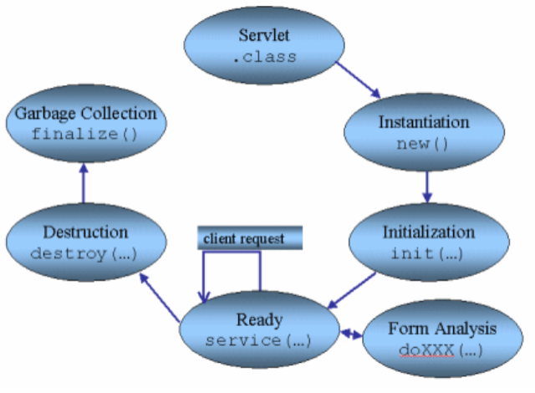
Servlet Lifecycle

Slide 11
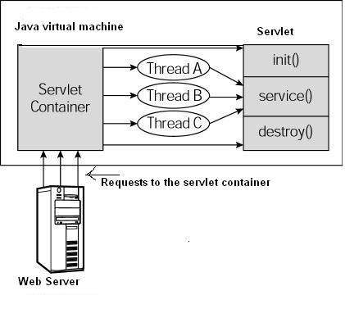
Servlet Lifecycle (cont.)
First the HTTP requests coming to the server are delegated to the servlet container.
The servlet container loads the servlet before invoking the service() method.
Then the servlet container handles multiple requests by spawning multiple threads, each thread executing the service() method of a single instance of the servlet.

Slide 12
The service() Method
The service() method is the main method to perform the actual task.
Each time the server receives a request for a servlet, the server spawns a new thread and calls service
The service () method is called by the container and service method invokes to the appropriate method.
You have nothing to do with service() method but you override either doGet() or doPost() depending on what type of request you receive from the client.
The service() method checks the HTTP request type (GET, POST, PUT, DELETE, etc.) and calls doGet, doPost, doPut, doDelete, etc. methods as appropriate.
The doGet() and doPost() are most frequently used methods with in each service request.

Slide 13


The doGet() and doPost() Methods
A GET request results from a normal request for a URL or from an HTML form that has no METHOD specified and it should be handled by doGet() method.
A POST request results from an HTML form that specifically lists POST as the METHOD and it should be handled by doPost() method.

Slide 14
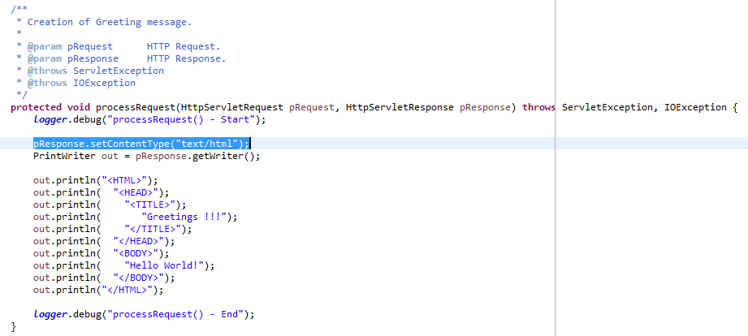
Simple Example
It is necessary to craft all the response by hand according to Content Type.

Slide 15
Servlet
A servlet is a small Java program that runs within a Web server. Servlets receive and respond to requests from Web clients, usually across HTTP, the HyperText Transfer Protocol.
Must implement the interface Servlet.
Extends of GenericServlet or HttpServlet.

Slide 16
Request
Extends the ServletRequest interface to provide request information for HTTP servlets.
The servlet container creates an HttpServletRequest object and passes it as an argument to the servlet's service methods (doGet, doPost, etc).

Slide 17
Response
Extends the ServletResponse interface to provide HTTP-specific functionality in sending a response. For example, it has methods to access HTTP headers and cookies.
The servlet container creates an HttpServletResponse object and passes it as an argument to the servlet's service methods (doGet, doPost, etc)

Slide 18
Session
Provides a way to identify a user across more than one page request or visit to a Web site and to store information about that user.
Implements interface HttpSession.

Slide 19
Context
Defines a set of methods that a servlet uses to communicate with its servlet container.
Implements interface ServletContext.
There one Context per application.

Slide 20
Request Dispatcher
Defines an object that receives requests from the client and sends them to any resource (such as a servlet, HTML file, or JSP file) on the server. The servlet container creates the RequestDispatcher object, which is used as a wrapper around a server resource located at a particular path or given by a particular name.

Slide 21
Attributes
A characteristic or object that qualifies another object.
ContextAttributes.
RequestAttributes.
SessionAttributes.

Slide 22
Parameters
It a value that a function needs.
Init parameters
requestParameters.

Slide 23
Filters
A filter is an object that performs filtering tasks on either the request to a resource (a servlet or static content), or on the response from a resource, or both.
Implements interface Filter.

Slide 24
Listeners
A class as an implementation of a listener interface.
On object that can monitor the state of another objects usually called events.

Slide 25
Links and References
Java Servlet Technology (http://docs.oracle.com/javaee/6/tutorial/doc/bnafd.html)
https://docs.oracle.com/javaee/7/tutorial/

Slide 27
Luis Robles
luisf.robles@softtek.com
Related to training material
(Java Web module)
Erio Cesar García Lujan
erio.garcia@softtek.com
Instructor

